Slide 1
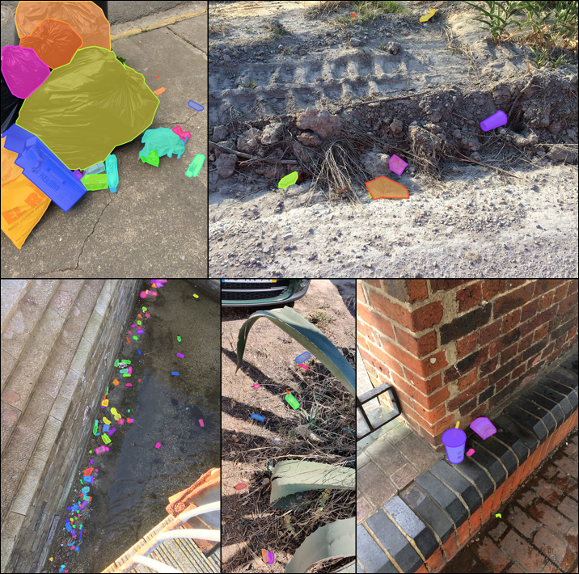

Searching for Litter with Computer Vision
Julian Hernandez
Mentor: Dr. Fitzgerald
California State University, Sacramento
MKN Heartland McNair Conference
September 2022

Slide 2
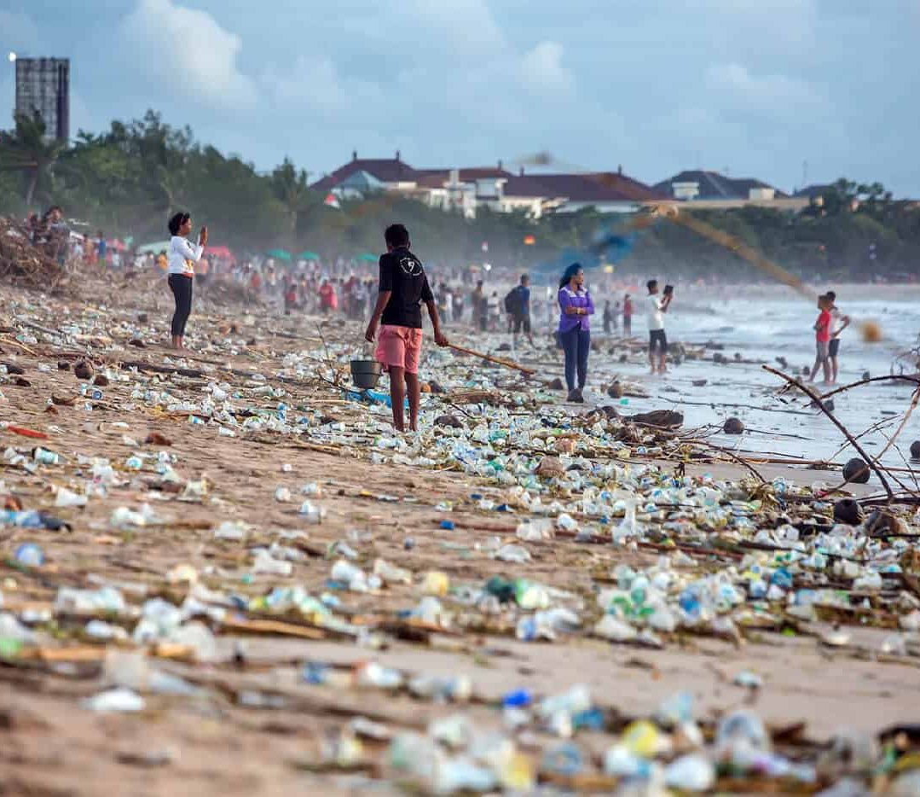
The Trash Problem
Causes harm to wildlife
Contaminates soil and ground water
Costs a lot of money to recycle
Releases green-house gas emissions

Slide 3
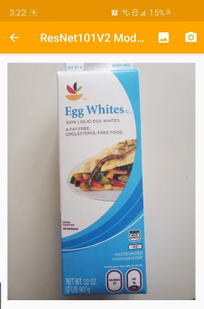
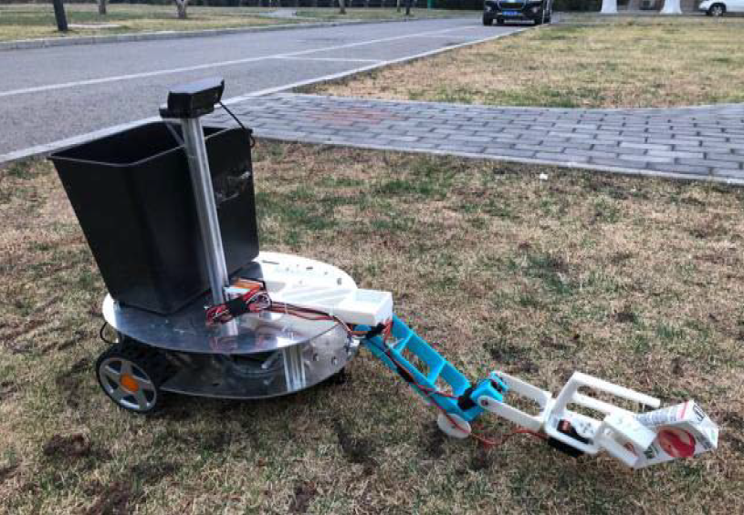
Early Trash Detection
An android app uses computer vision to classify trash into 6 material types on a blank background
A prototype trash cleanup robot designed to clean up trash in grassy areas showed promising results

Slide 4
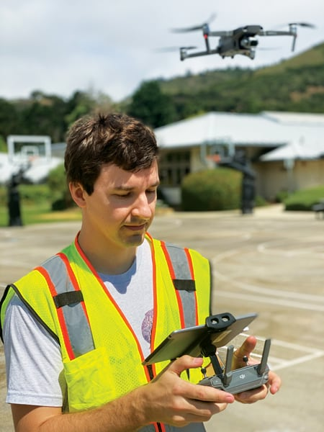
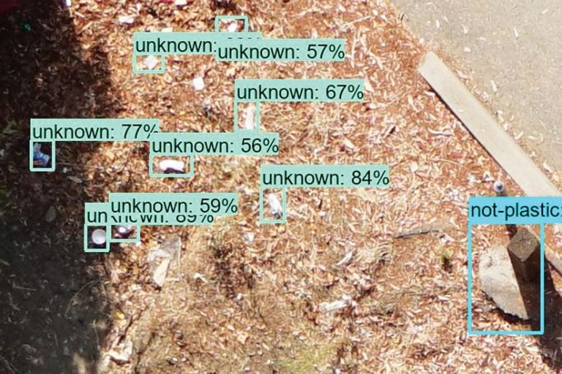
California Regulations
In 2015 new regulations Department of Water Resources require cities to measure plastics
San Francisco Estuary Institute (SFEI) uses computer vision to “find the best ways to filter their stormwater and stop contaminants such as trash and plastics from entering their protected wetlands and public waterways” Hale

Slide 5
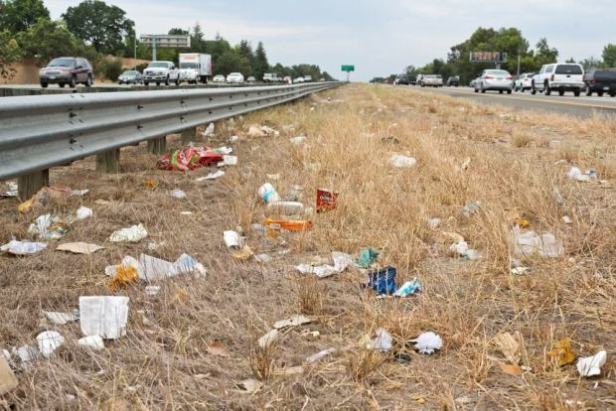
The Problem: Quickly Measuring Trash
How do we measure trash now?
Qualitative: Site scoring uses average assessments to score a site from 1-12
“this method is subjective and depends on the assessor’s perception of trash conditions” (SFEI)
Quantitative: Volume based approach is more precision but requires a lot of time and resources
Up to 3 hours 30 minutes for a 300ft site

Slide 6
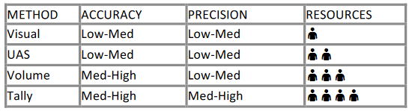
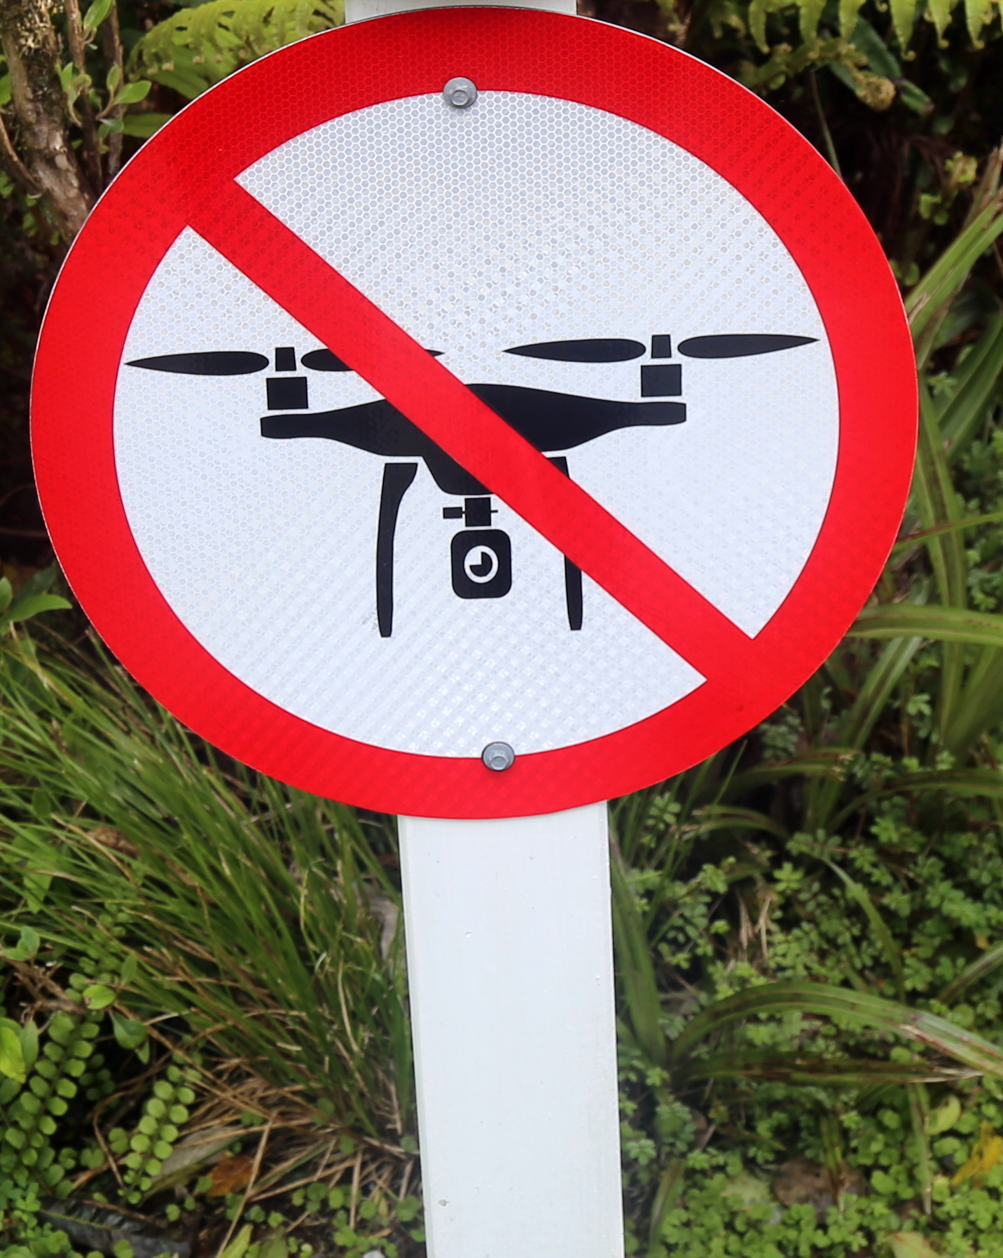
Unoccupied Aerial Vehicle (UAS) Count
Best accuracy came from lower flights
The closer the object the easier to identify
Problem: Drones aren’t allowed everywhere
Field Testing Report - Trash Monitoring Methods

Slide 7
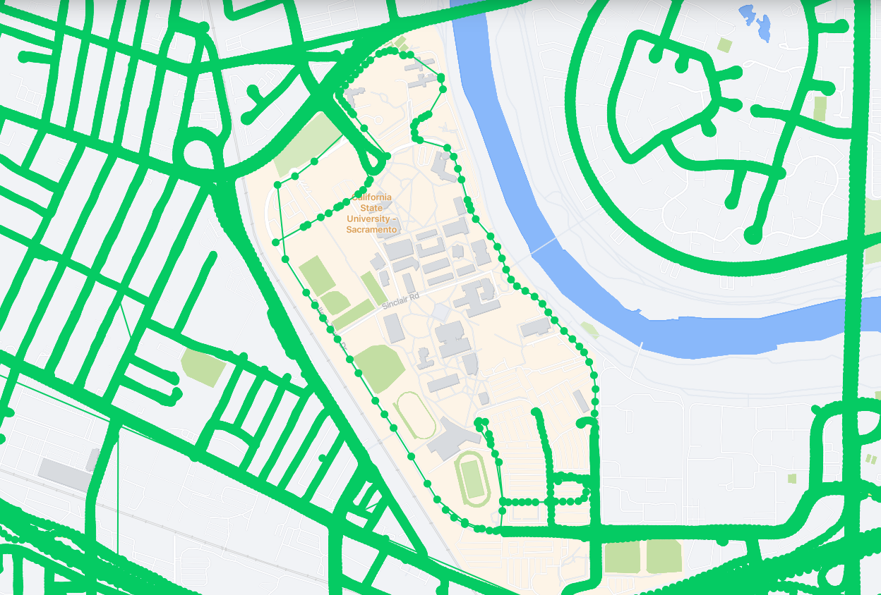
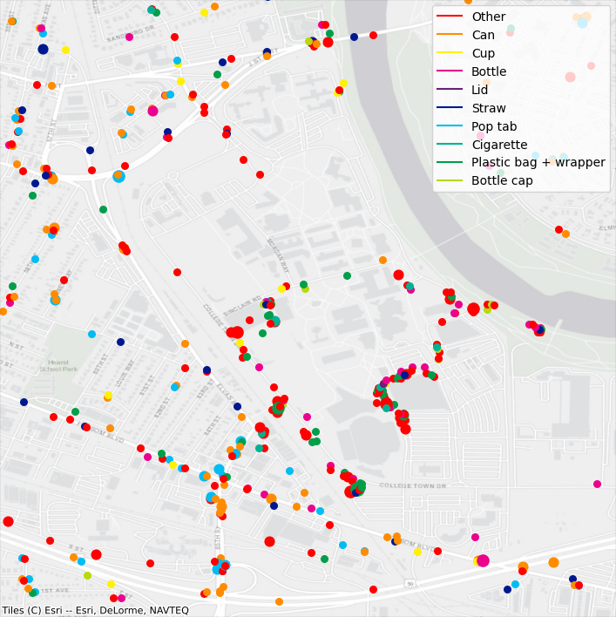
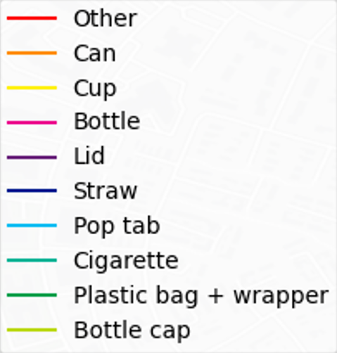
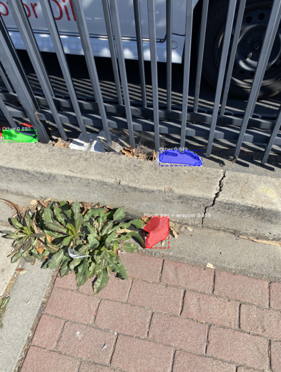
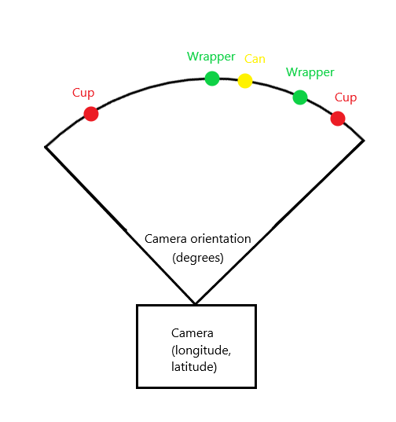
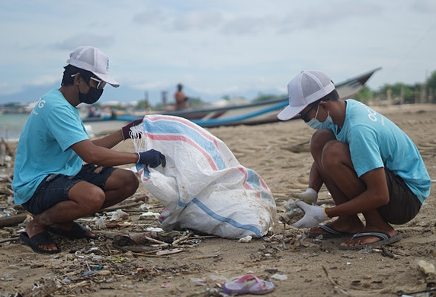
Goal of this Research
Can computer vision quantify street-side litter from collected images?
Geolocate items
Plot detections
Collect images
& datasets
Detect trash

Slide 8
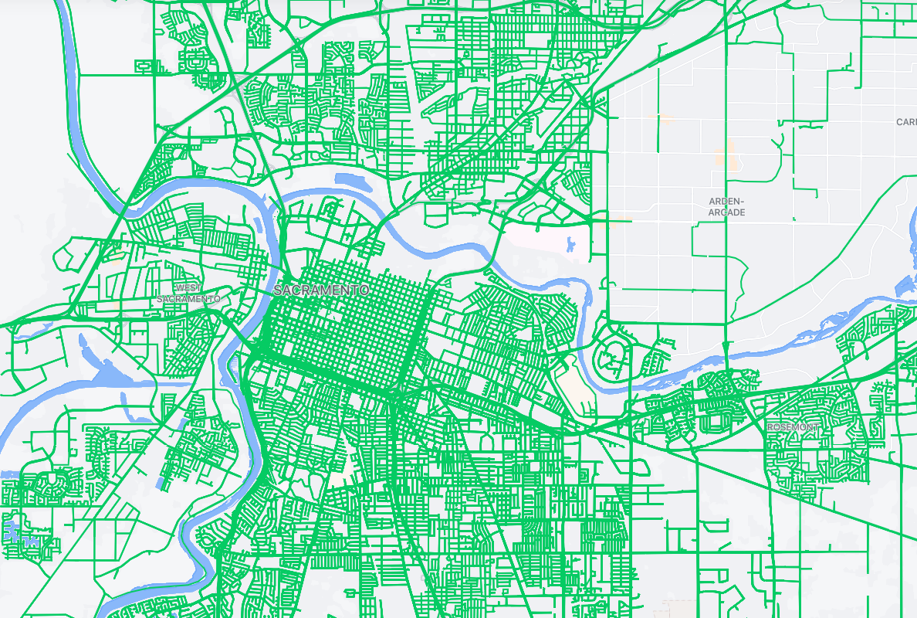
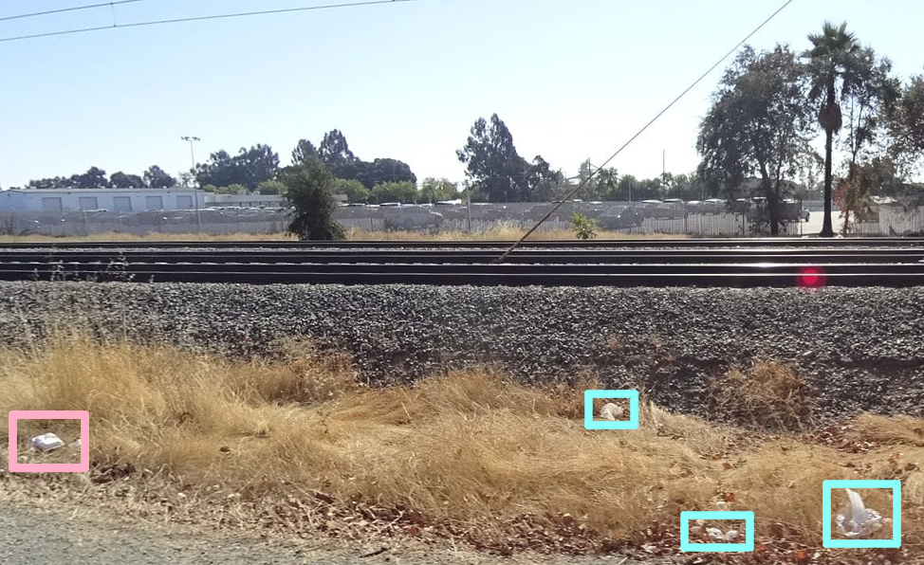
Street Level Images: Mapillary
Began collecting dashcam footage in 2013
Coverage for the 190 countries’ road networks
Mapillary image cover near Sacramento State University
Sample Mapillary image with trash

Slide 9
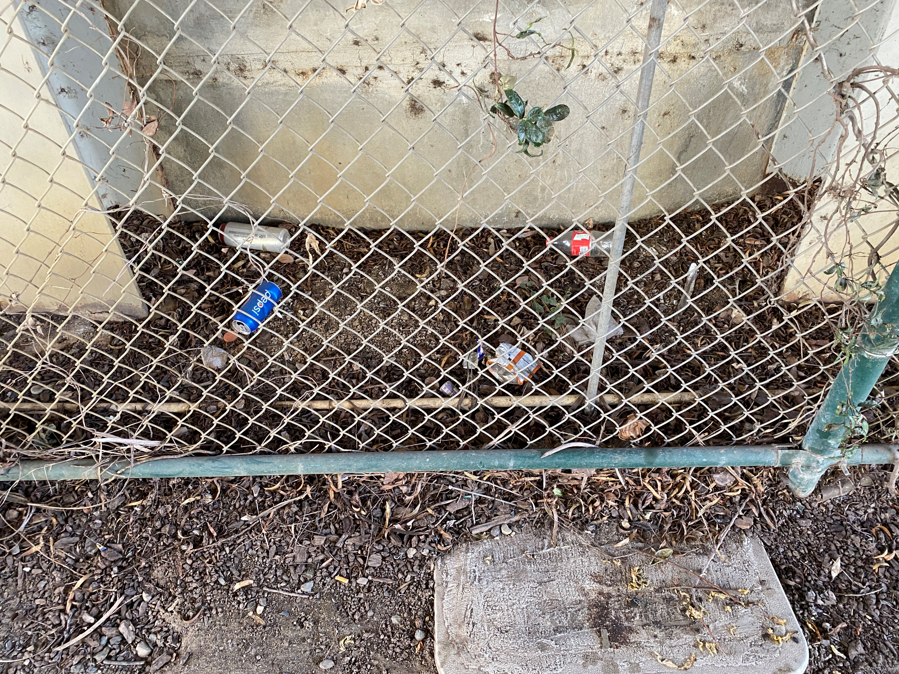
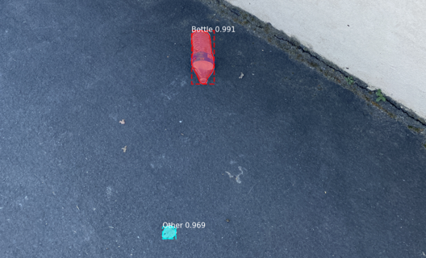
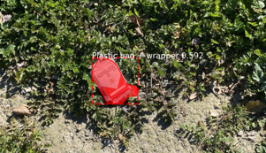
Cleanup Images
Collected 150 images from around Sacramento State University
Can be taken on any smartphone or handheld device
Coordinates and other metadata are automatically stored

Slide 10
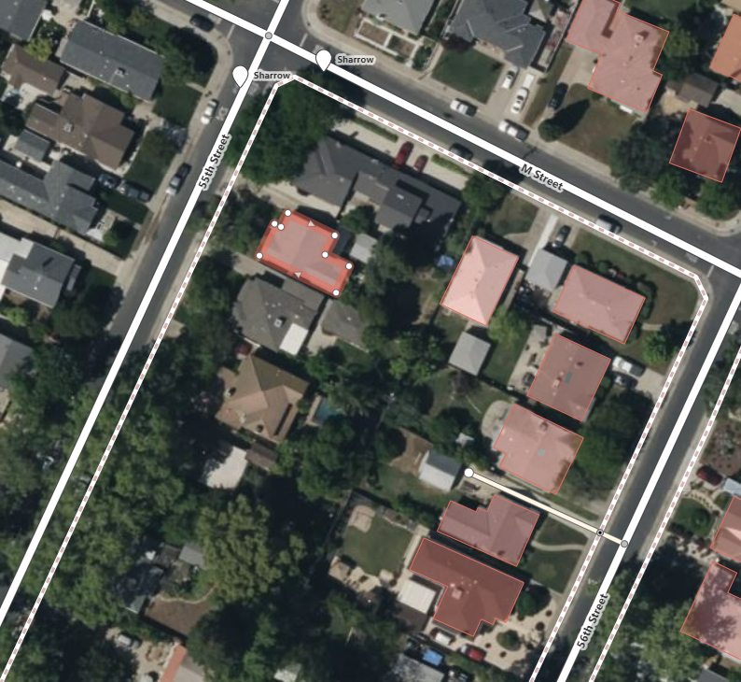
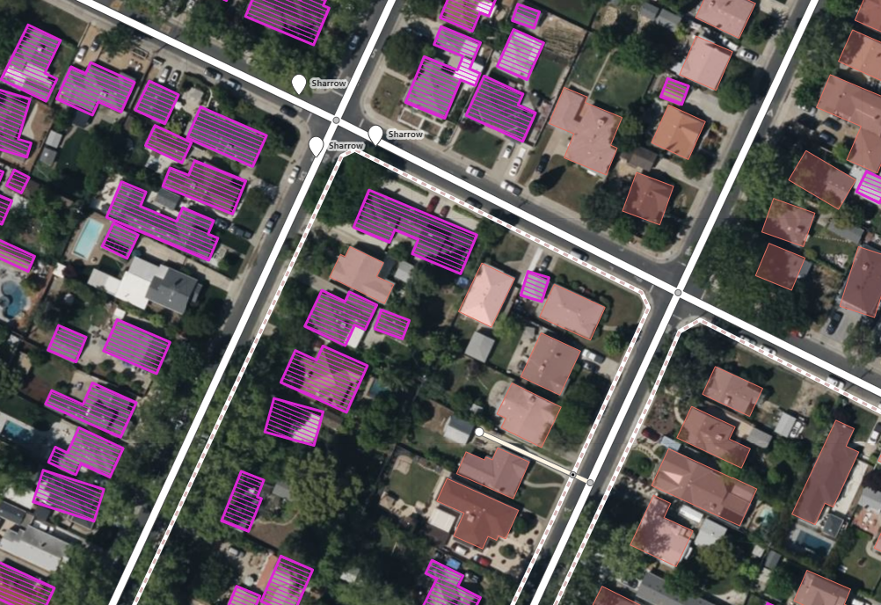
Mask Regional Convolutional Neural Network (Mask R-CNN)
Facebook releases a plugin using Mask R-CNN to suggest building outlines for OpenStreetMap
Building shapes were used as training data, allowing it predict new rooftop outlines
Training data (Red)
Training data (Red)
Mask R-CNN predictions (Purple)

Slide 11
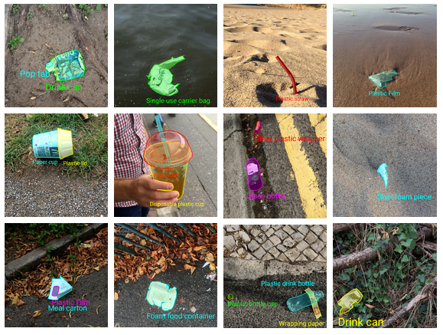
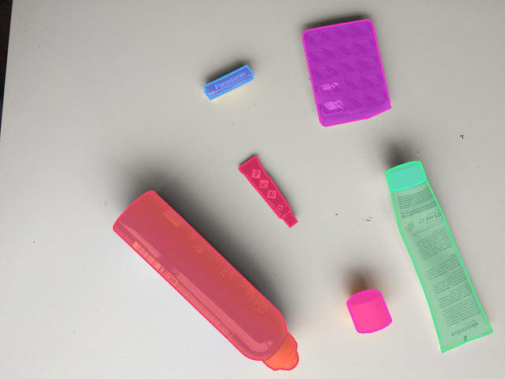
Trash Annotations in Context Dataset (TACO)
Researchers pre-trained multiple Mask R-CNN models on 1,500 annotated images
We selected 10 categories

Slide 12
Localization
EXIF metadata contains photo coordinates, camera orientation, date and time, etc
Depth must be derived from object size
Pedro F. Proença (co-author of TACO dataset) went on to research RGBD (Red, Green, Blue, and Depth)

Slide 13
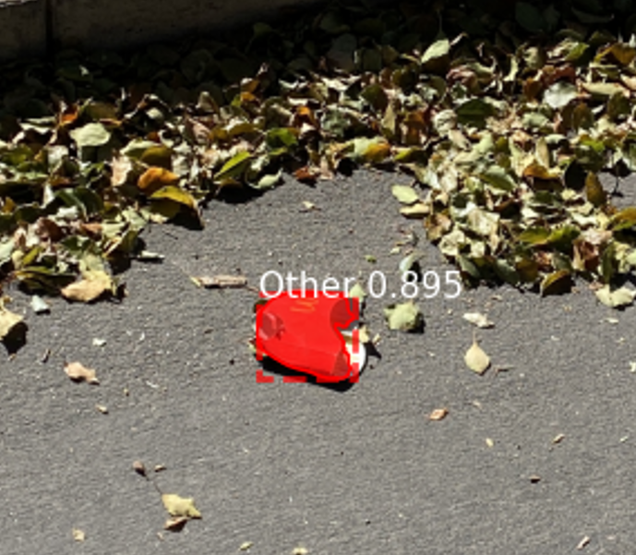
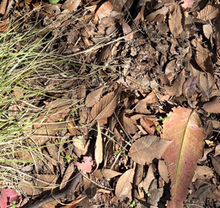
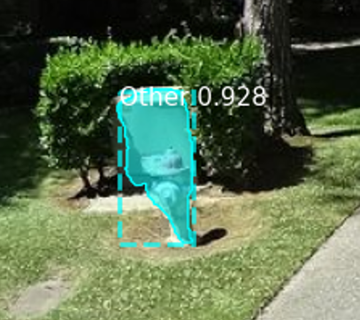
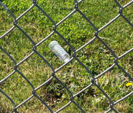
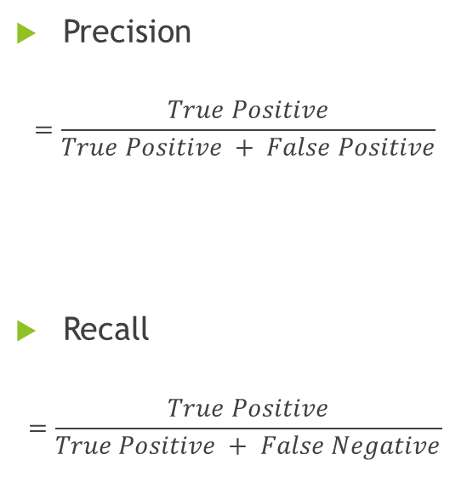
Metrics
 | Positive | Negative
True | True Positive (TP) | True Negative (TN)
False | False Positive (FP) | False Negative (FN)
Precision
$$=\frac{True Positive}{True Positive + False Positive}$$
Recall
$$=\frac{True Positive}{True Positive + False Negative}$$

Slide 14
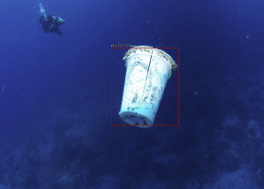
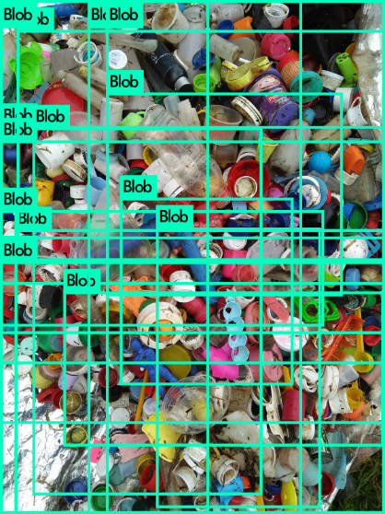
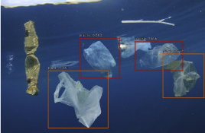
Previous Results
TrashNet precision with video:
Precision: 68%
Recall: 69%
National College of Ireland:
Precision: 69%
Recall: 69%
AuqaVision based on TACO:
Precision: 81%
Recall: Not reported
SFEI Field Testing Report:
Precision: 4%
Recall: 10%

Slide 15
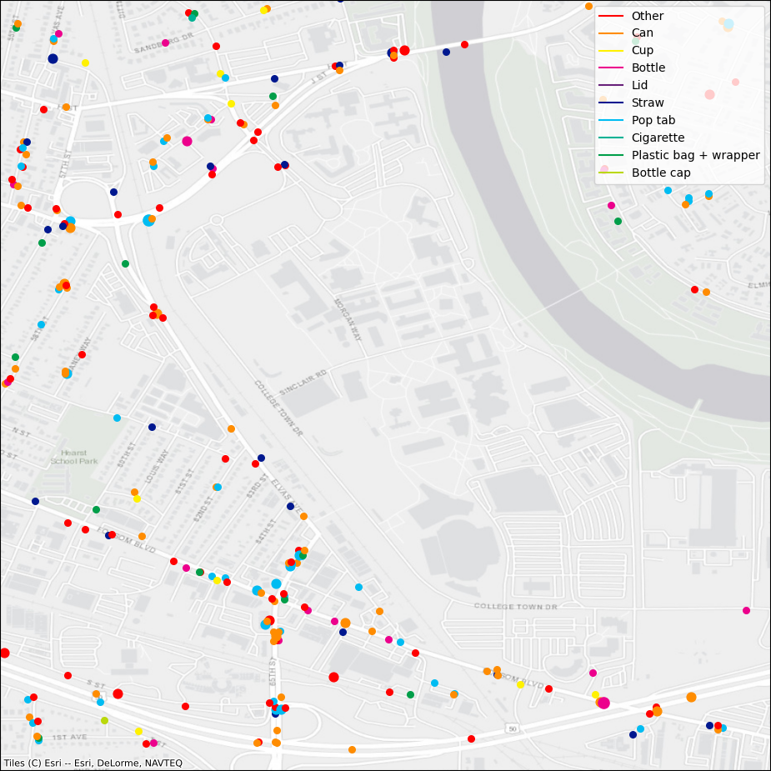
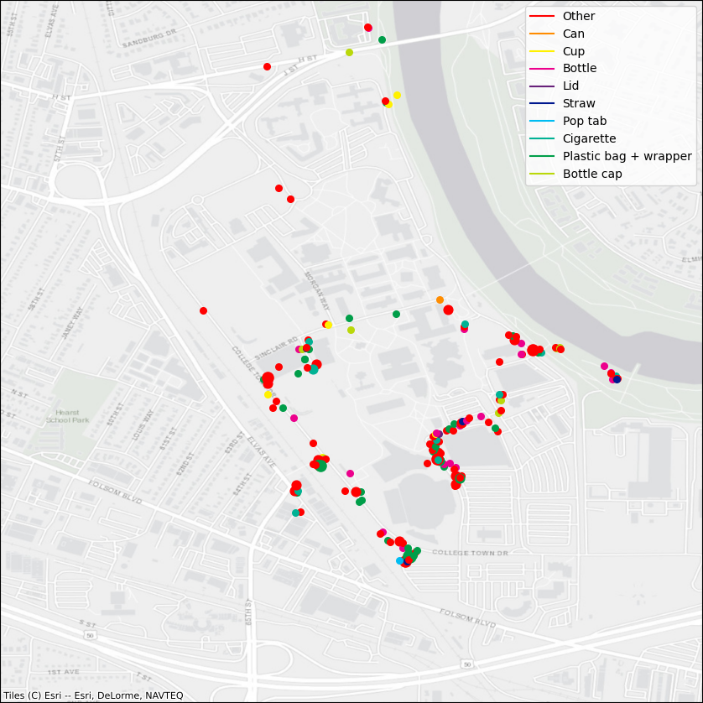
Results
River Cleanup: Precision = 81% Recall = 74%
Mapillary: Precision = 1% Recall = 3%
Mapillary dash cams
Why did the algorithm perform as expected with smartphone images while failing to do the same with Mapillary images?
Smartphone images

Slide 16
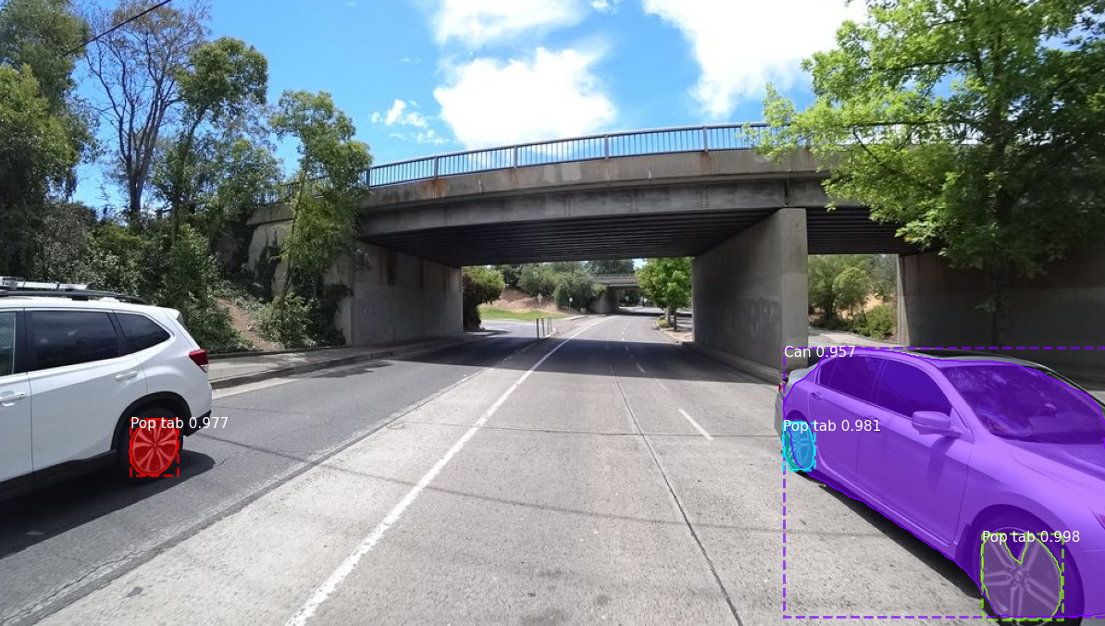
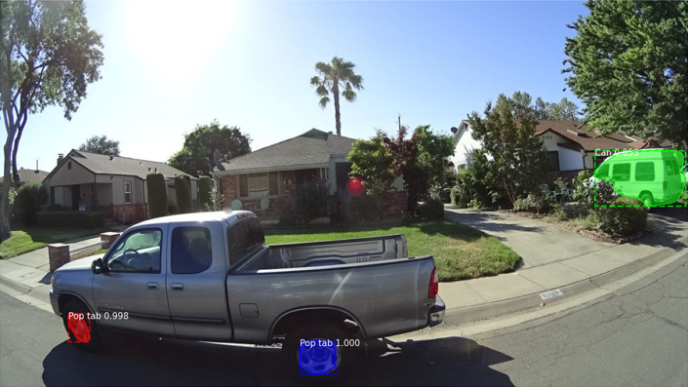
Problems
Low resolution Mapillary images
Less pixels = more noise
Model was overfit to TACO dataset
The dataset needs more diverse images
50% of false positives were from car misclassifications alone
Common features: Texture, color, and shape

Slide 17
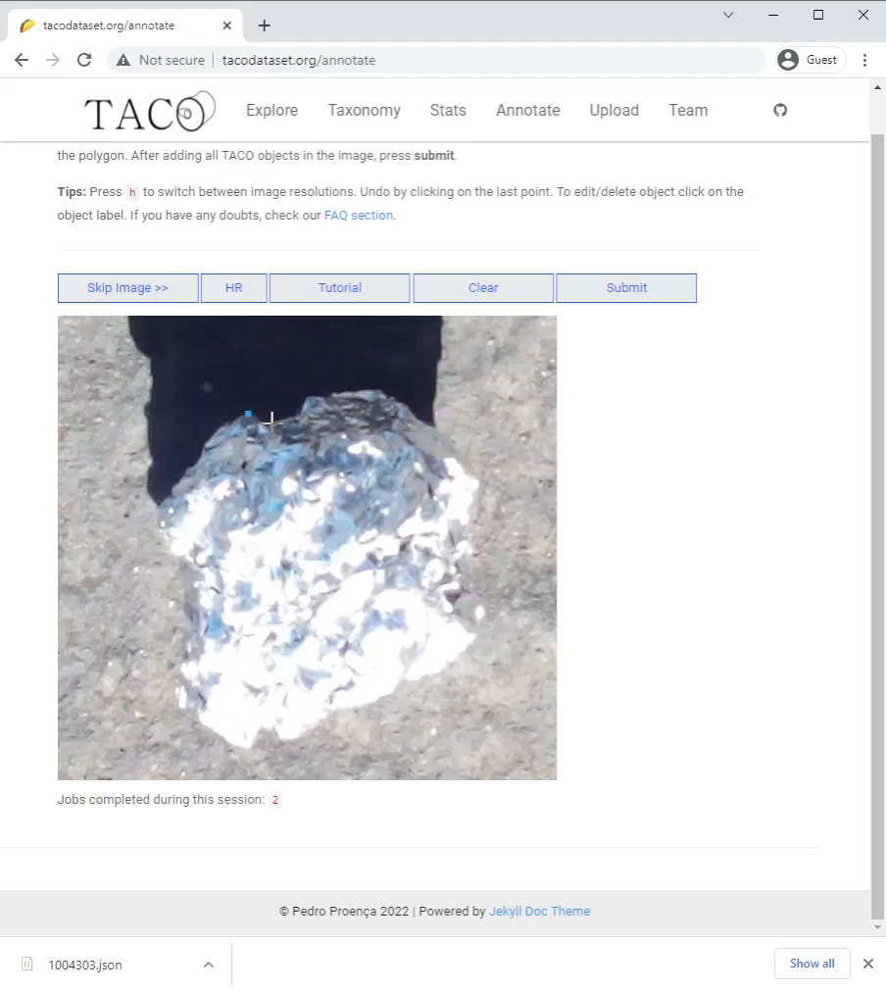
Dataset & Model Improvement
TACO is based on COCO but is ~200x smaller
Trash Annotations in Context (TACO):
1,500 images
4,700 outlined objects
Common Objects in Context (COCO):
300,000 images
2,000,000 outlined objects

Slide 18

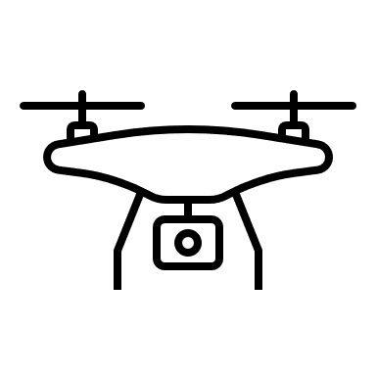




Model Feedback
Train model on a diverse set of images from smart phones, drones, dashcams, mounted cameras, etc.
Continually update database with new images so that the algorithms is constantly developing

Slide 19

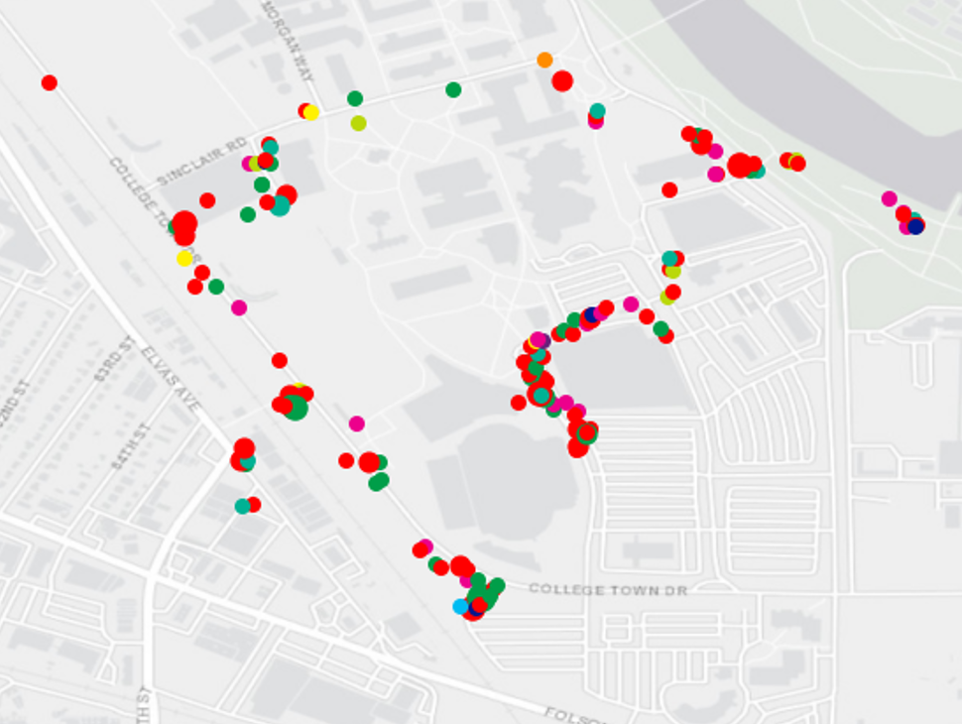
Application: Quantify Zero Waste Efforts
How do cities measure the effectiveness of waste management policies?
Measure the starting amount of trash in the environment to establish a baseline
Quantify clean up totals and compare this against the baseline counts
Allow researchers to look at geographic trends over time

Slide 20
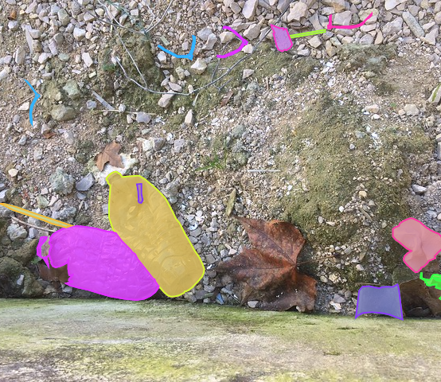
Future Work
How to deploy trash detection models to make real world improvements?

Slide 21
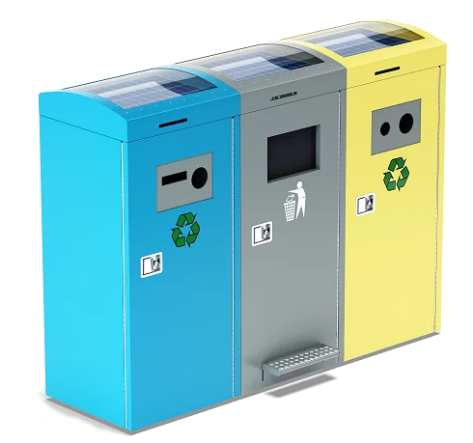
Smart Composting & Recycling
Does suggesting the correct bin increase recycling rates?
California has a “42% recycling/composting rate in 2020, up from 37% the year before. California’s goal for 2020 had been 75%, however.” resource-recycling.com

Slide 22
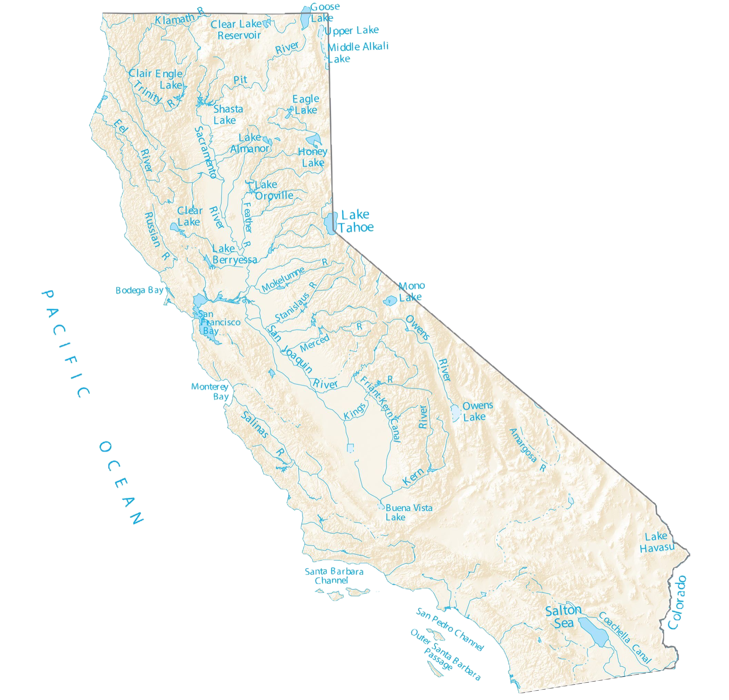
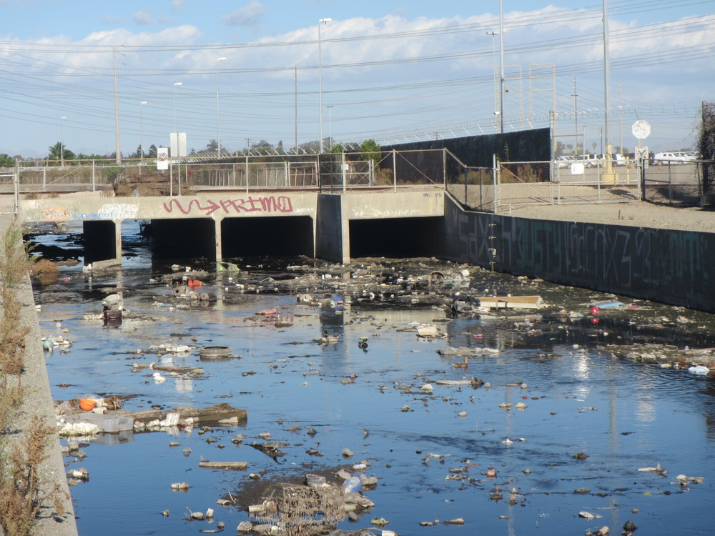
Measuring plastic in Waterways
How can the amount of trash entering and exiting the waterways be monitored?
Work with recollect, City of Sacramento, San Francisco Estuary Institute (SFEI)

Slide 23
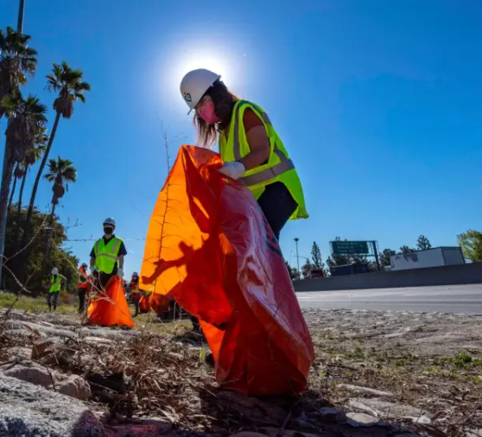
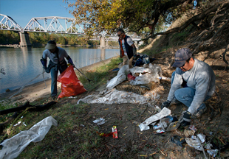
Conclusion
What is the problem?
Measuring trash levels must either be done quickly or accurately
How do we fix this?
By automating the process of labeling and plotting images, volunteers can assess a site much faster and with higher accuracy
How will this help?
Enable cities to measure the effectiveness of zero waste policies

Slide 24
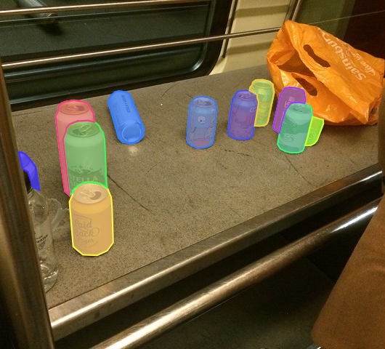

Questions?
References available by email julianofhernandez@csus.edu

